Slide 1
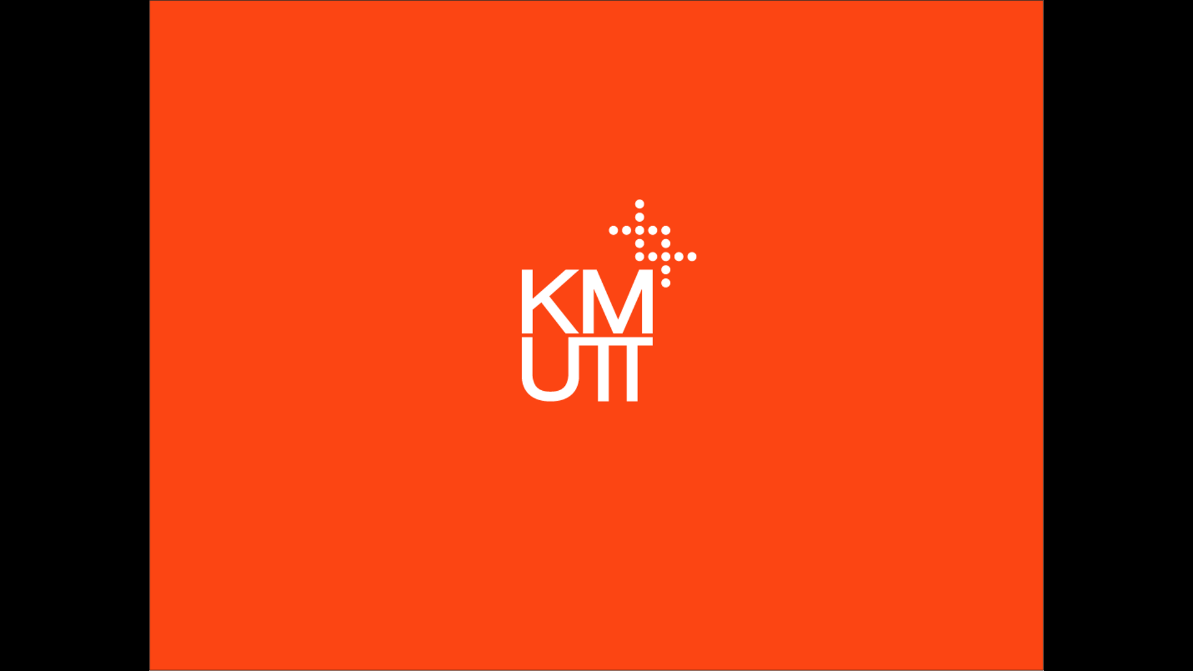

Slide 2
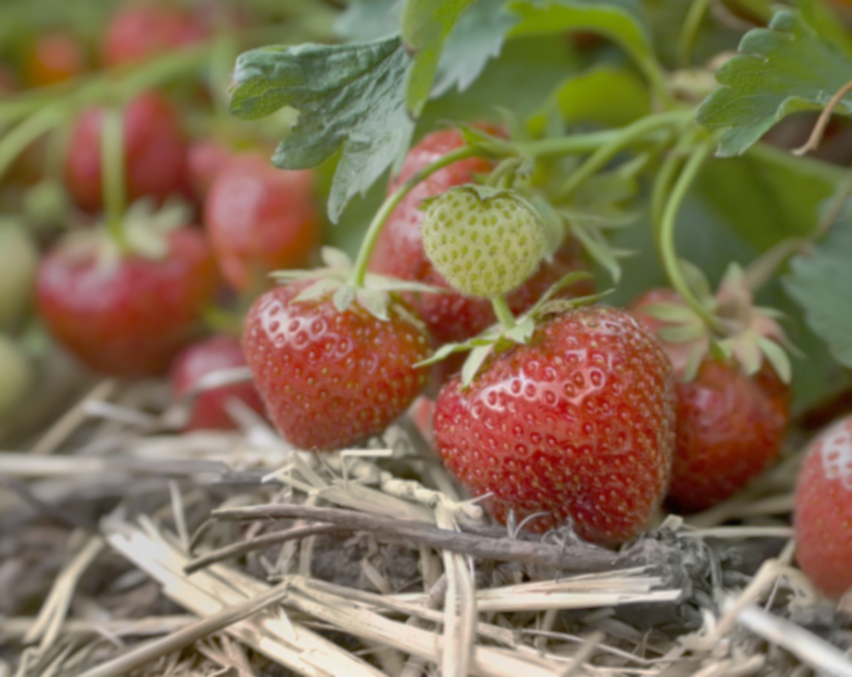
260,000tons
of fruit and vegetables are wasted during harvesting worldwide
Notes:
good afternoon have you ever wonder how many fruits and vegetables are wasted per year 260000 tons are wasted during harvesting
worldwide 45% waste fruits have one of highest waste rate of any food products

Slide 3
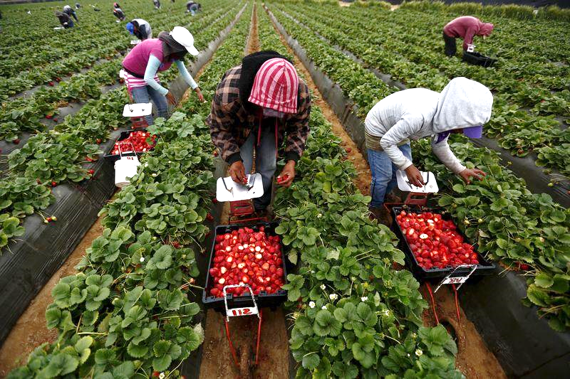
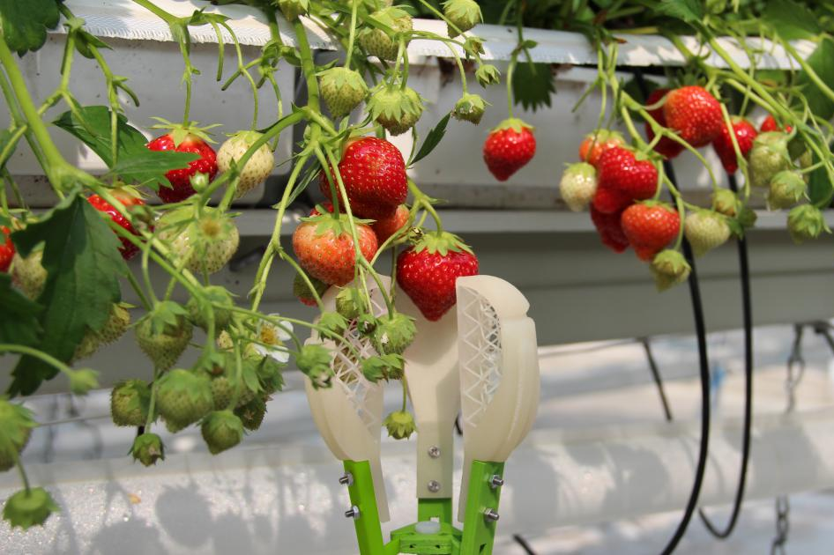
EXISTING PROBLEMS & PRACTICES
Manually Picked
Conventional Gripper
Costly
Slow
Labor Intensive
Costly
Rigid
Damage fruit during harvesting
Difficult to adjust for various size of fruits
Notes:
poor harvesting practice because in the whole world most fruits are manually picked it costly and slow there are some robotics companies that try to use robotics solutions to pick fruits however most of the companies use a conventional gripper which is a rigid gripper that costly and damage fruits during harvesting and it also very difficult to be adjust for various size and types of fruits

Slide 4
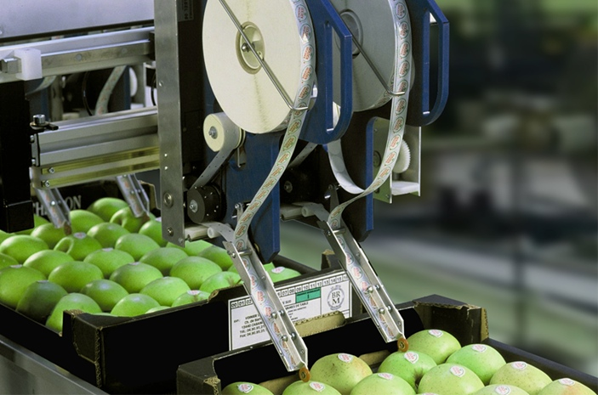
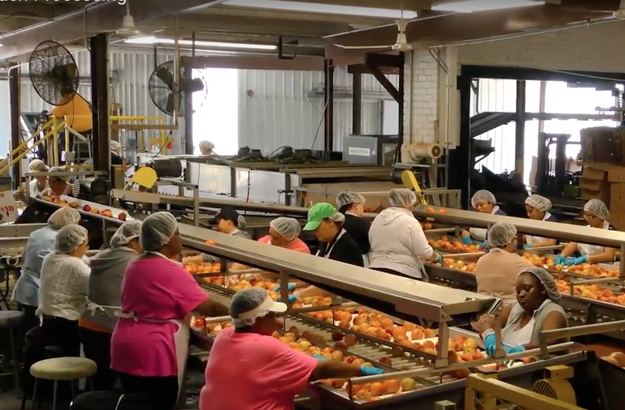
CURRENT PACKING PROCESS
Automation
Manually Packed
Limited to Cleaning and labeling
Very labor intensive
Slow
Notes:
Compare---now, lets take a look at packing process some of the packing process can be done by automation such as cleaning process or labeling it however even today most the box packing process is done by human as you see in this picture humans are used in this process because it very difficult to design a robotics gripper or robotics system

Slide 5
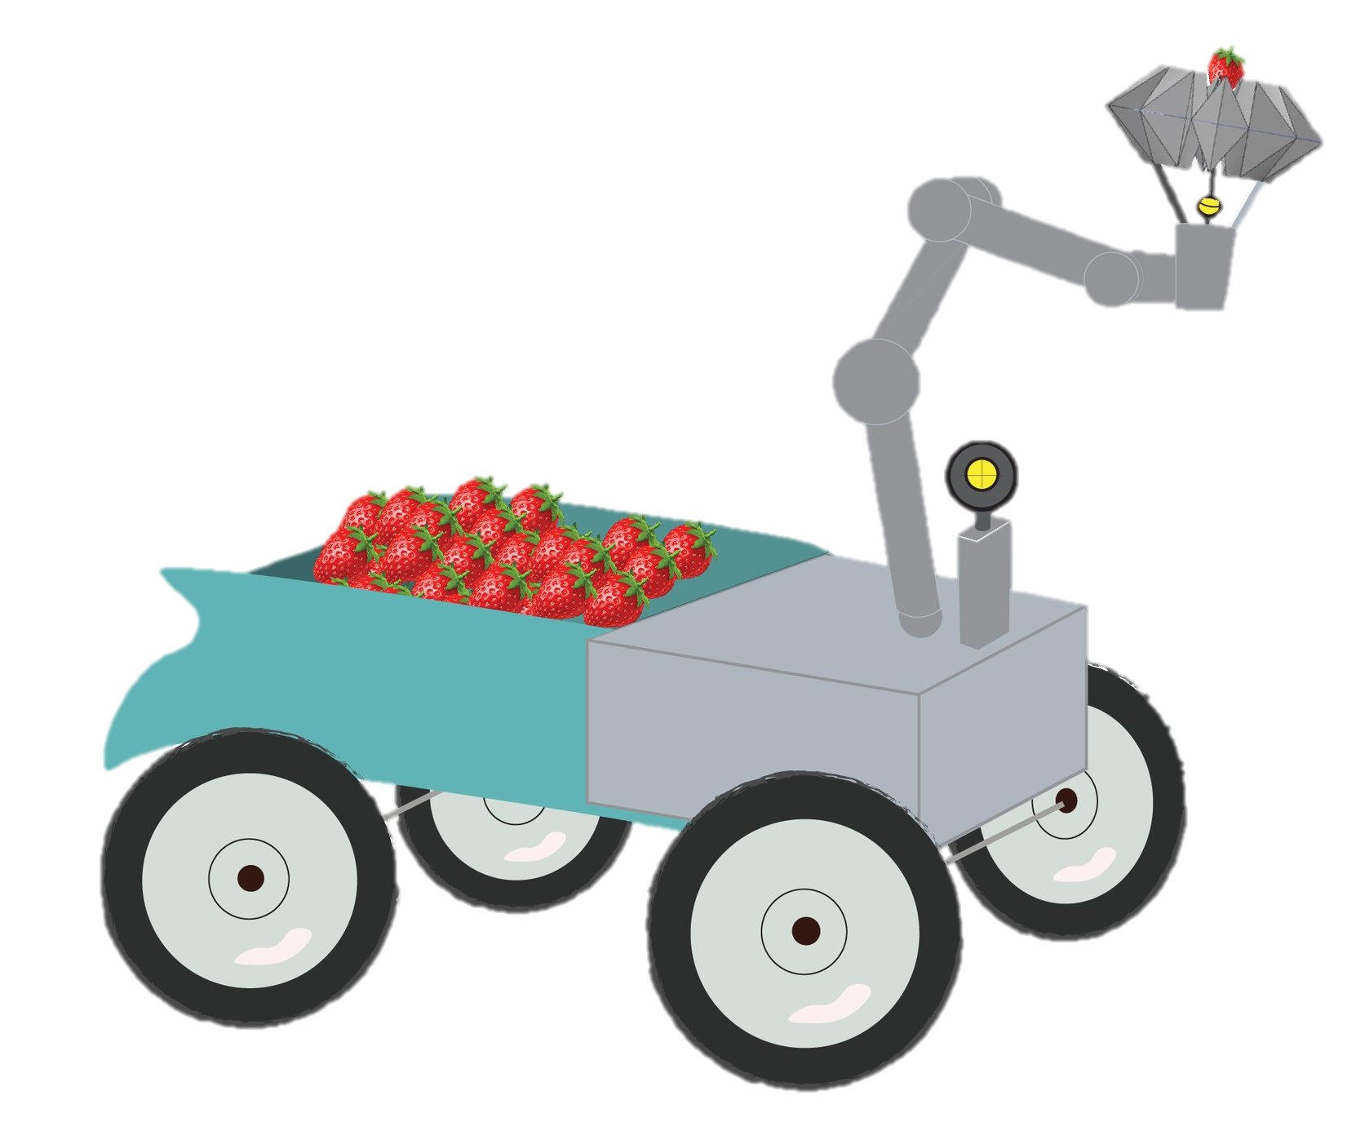
OUR INNOVATION
ARGORIBOT
Notes:
therefore here we proposed the new solutions for farmer our innovation is argoribot

Slide 6
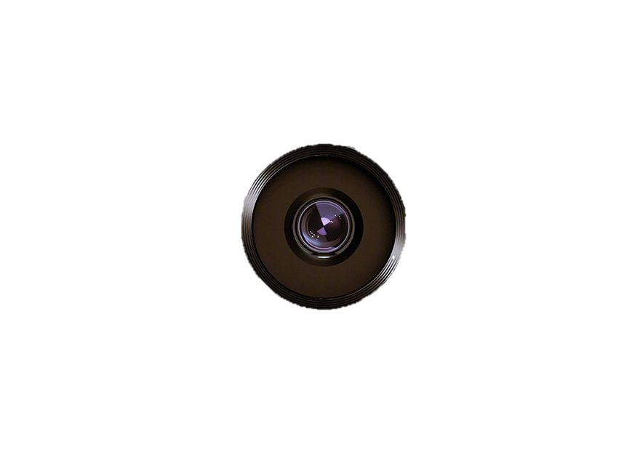
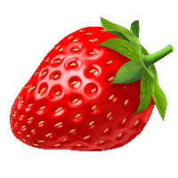
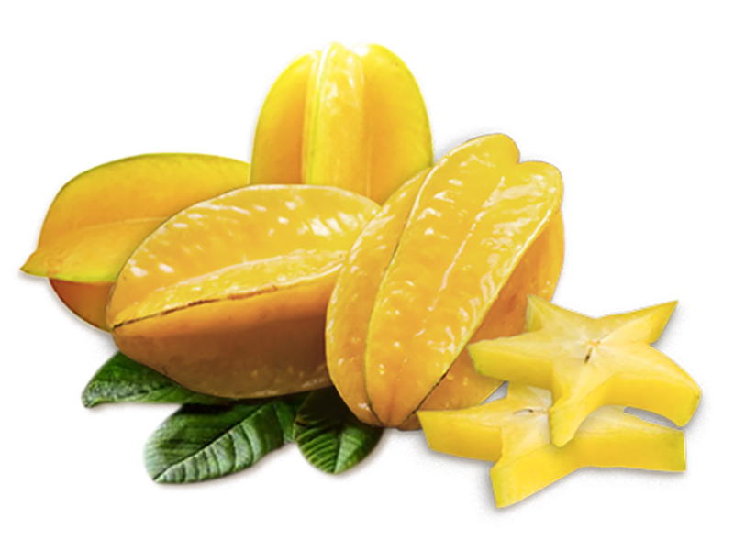
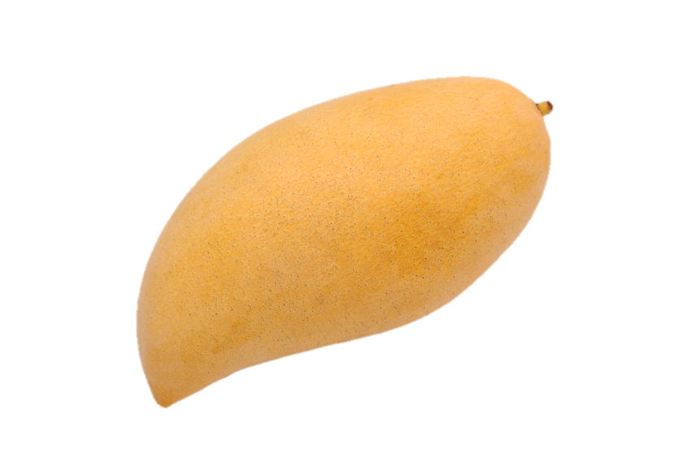
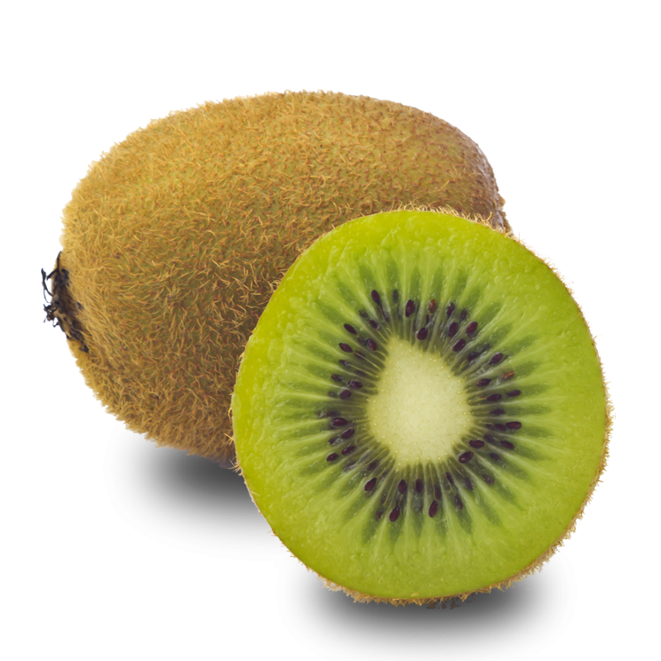
SHAPE
POSITION
SIZE
Detect fruit position
Adjust for various size of fruits
Notes:
argoribot is a mobile robot that has camera for detect the position of fruit and soft gripper to harvest the robot can grasp or pick fruit with various size and we can apply this gripper for various kinds of fruits that easy to damage by gripper like mango kiwi peach star fruits cape gooseberry and plum all these different shape fruit can pick by this gripper

Slide 7
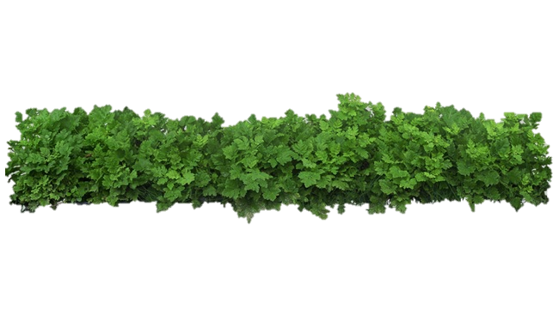


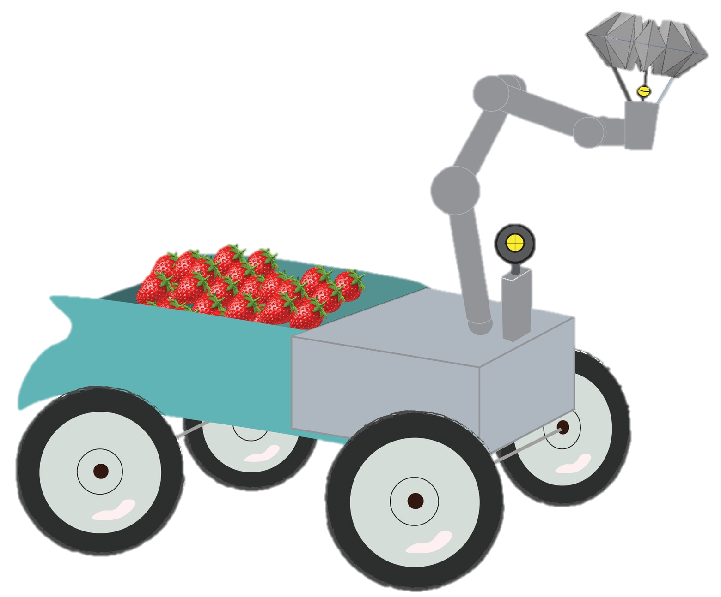
ARGORIBOT
PROCESS
Grade B
60%
80%
Grade A
10%
DETECT
DETERMINE RIPENESS
DETERMINE SIZE
PICK UP
PACKING
Image Processing
Image Processing
Image Processing
Using soft gripper
Using soft gripper
Notes:
the process of argoribot is an all in one process the robot can go into the farm and at first robot detect the position of fruit and determine ripeness (for example…) and estimate size of fruits then robot can grasp the fruit after that it will pack into box we can also optimize the amount and position of fruits in the box by using artificial intelligence solutions and our soft gripper

Slide 8
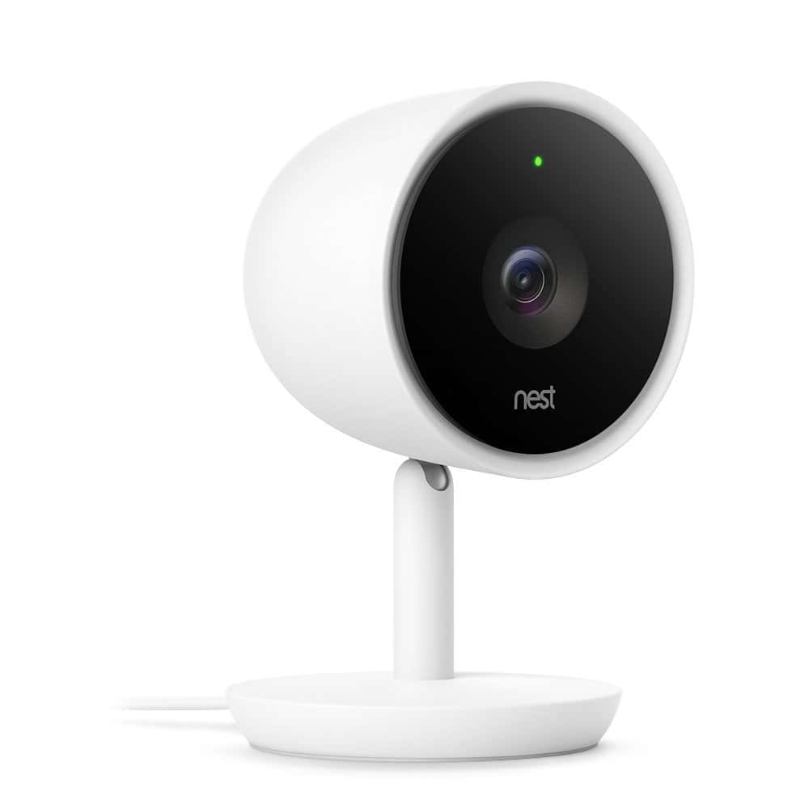
Visual inspection
Image Processing
Artificial Intelligence
Detect fruits on plant
Determine fruit ripeness
SMART CAMERA
Optimize fruit weight per box
Notes:
I want to explain a little bit more about details. With the image processing technology theses day we can determine fruits ripeness and we can sort fruit to pack number of fruits in the box that has a proper size so when you want to say this is the box this will be large size fruit in one box or this one is for smaller size to sell it cheaper so you can optimize the process in our single robot so it very very easy for farmers to use our robot

Slide 9
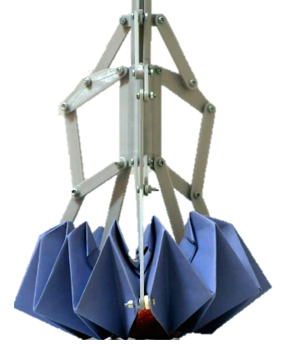
Waterproof paper
12 fingers
No additional sensor
Grasps different types of fruit
Minimum grasping force
Easy to replace
ORIGAMI DESIGN
Inexpensive
Notes:
We propose our innovative gripper design. this gripper not a normal gripper. It actually made by a waterproof paper inspired by a origami concept called modular origami. we folded the paper into this shape which has 12 finger. Our gripper is not like any other because it `is made by paper so it can blend when it forms around fruits therefore it can grasp different types of fruits different shapes different size and it doesn’t apply more force than it need at all it will blend to the shape of the fruits

Slide 10
OUR GRIPPER
AGRORIBOT GRIPPER
CONVENTIONAL GRIPPER
12 Fingers
2-4 fingers
Various shapes sizes,
gentle
Limited shapes
COMPARATIVE ANALYSIS
No sensor
Sensor
No computation
Computation
Cheap
Expensive
EASY
Overly Complicated
Notes:
As you can see in this table, our gripper has 12 fingers where existing gripper has 2 to 4 fingers and we don’t need additional sensor, computational and additional equipment such as air pump or hydraulic fluid sat all moreover because it made by paper it can be easily replaced and inexpensive

Slide 11

ORIGAMI GRIPPER
Notes:
:this is a prototype of our gripper, we have detached it from the motor to show you how the gripper works

Slide 12
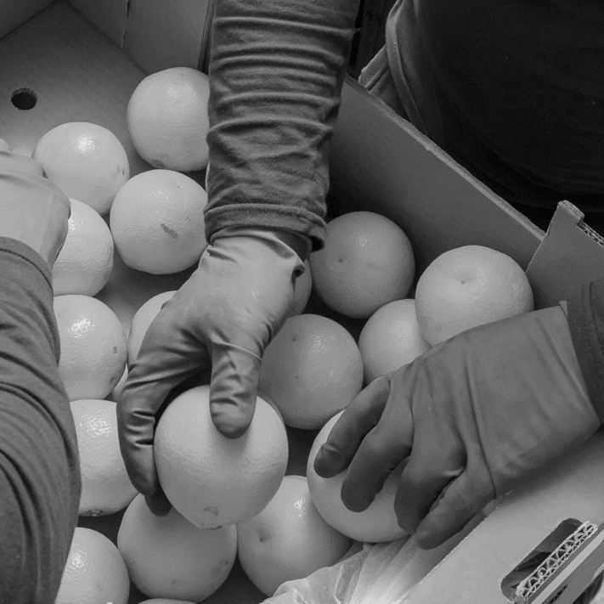
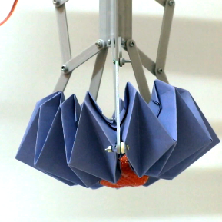
Harvesting & Packing per person
Manually Picked
ARGORIBOT
Harvesting & Packing
per robot
45 Kg /1 hour
100 Kg / 1 hour
Fixed time
24 hours
Notes:
And to give you the real number now ,when you think about the process of manually picked For one hr Reduce number of worker in harvest and packing

Slide 13






WHY ARGORIBOT ?
Reduce and Eliminate waste during harvesting
Save time by improving efficiency
Decrease workspace injuries
Increase profit margin
Create a new generation of farmers
Notes:
so why would we use argoribot it can reduce and eliminate waste during harvesting it can save time because we put the two processes-- harvesting and packing in one process that will improve efficiencies in fruit production. it also decreases risk during harvesting,… imagine how dangerous it when we have to climb and pick fruit from a tree, this innovation would eliminate this problem. moreover this create significant environmental and economic benefits ,260000tons is a lot of waste and it can be reduce significantly with ARGORIBOT.

Slide 14





OUR JOURNEY
System Testing
On Going
System Integration
Software Design
Hardware Development
Conceptual Design
Notes:
since we came up with this idea we actually came up with the conceptual design of this robot we have also finish the hardware development , you can see the gripper we designed it, made it and test it to grasp various objects and NOW we are in the process of software development at this moment and in the future we will have to develop systems integration and testing in the field before it is ready to sell.

Slide 15





OUR PARTNERS
Robot companies &
Research Institute
Agriculture companies
Notes:
to make our innovation the best we currently collaborate with the robotics company and research institute which develop robotics systems and agriculture companies which support to deploy in the field

Slide 16


MAKE AGRICULTURE SMARTER.
Notes:
JOIN US AND MAKE AGRICULTURE SMARTER

